Slide 1

Quant Week 3
2/8/24
Notes:
Complete

Slide 2

Agenda
Icebreaker Question
Brainteasers
Market Making, continued
Market Making Game
Python/Conda Set Up
Project

Slide 3
Ice Breaker
What is the worst class you’ve ever taken?

Slide 4
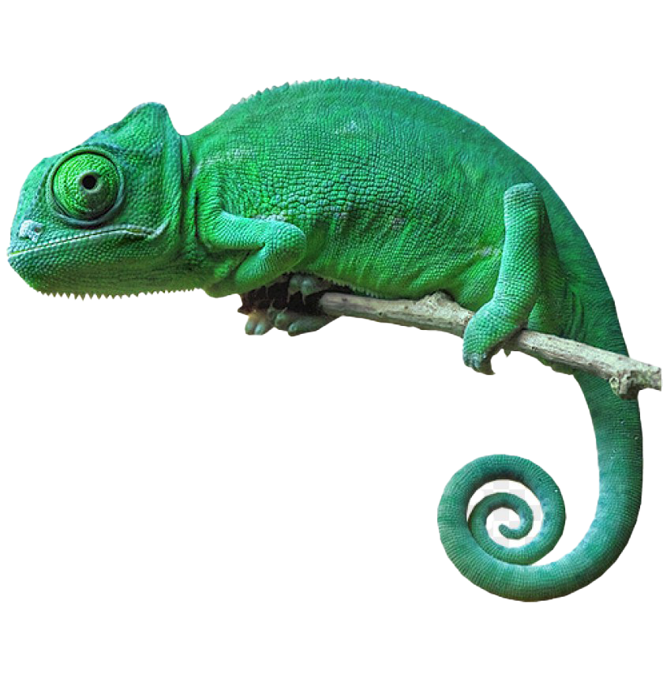
Brain Teaser - Chameleon Colors
A remote island has chameleons that can change between 3 different colors: red, green and blue
When two chameleons meet, they will change their color to the third color (example red and blue ones meet, they become green)
If there are 13 red, 15 green, and 17 blue chameleons,
(13,15,17) is it ever possible for all the chameleons to
be the same color?

Slide 5
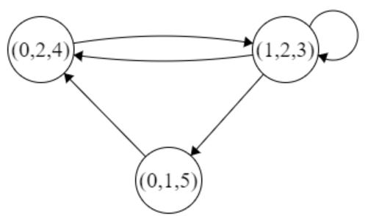
Brain Teaser - Answer
This problem can be reduced to 0 red, 2 green, and 4 blue chameleons (0,2,4).
This is because any (1,1,1) can become (0,0,3)
These are the possible states from (0,2,4):
The combination (1,2,3) can be further reduced to (0,1,2), which can never reach (3,0,0). (0,1,2) will repeat, and will always return to (0,1,2)

Slide 6
Market Making

Slide 7
Order Matching System
The system that exchanges use to match bids and asks
All electronic exchanges rely on these systems, also known as matching engines
Matching engines are common topics in interviews
Some firms (IMC) may ask you to implement a basic matching engine
Two states
Continuous: Orders matched immediately
Auction: Orders matched at fixed intervals, often is used at the start of a day when orders have built up.
Implementation of these generally uses a priority queue/stack

Slide 8
Order Book Example
Bid (Volume) | Price | Ask (Volume)
 | 100.03 | 150
 | 100.02 | 100
 | 100.01 | 50
 | 100
60 | 99.99
120 | 99.98
180 | 99.97

Slide 9
Order Book Example
Bid (Volume) | Price | Ask (Volume)
 | 100.03 | 150
 | 100.02 | 100 (SOLD)
 | 100.01 | 50 (SOLD)
 | 100
60 | 99.99
120 | 99.98
180 | 99.97

Slide 10
Order Book Example
Bid (Volume) | Price | Ask (Volume)
 | 100.05 | 250
 | 100.04 | 200
 | 100.03 | 150
 | 100.02
60 | 100.01
120 | 100.00
180 | 99.99

Slide 11
Market Making Game

Slide 12
Game
Similar to Jane Street Estimathon, or Optiver’s market making game
A question will appear on screen, and one person will make a market
Everyone must then either buy or sell on that market
The role of market maker will rotate such that everyone is the market maker once

Slide 13
1: The Population of Montenegro

Slide 14
2: Exponential of the EECS 281 late withdrawal rate

Slide 15
3: The Sum of the Class Numbers that Toland and I are taking

Slide 16
4: The amount of people living in South Quad divided by pi

Slide 17
5: The area of Morocco (sq mi)

Slide 18
6: The percentage on Patrick’s phone right now times 50

Slide 19
7: The FY23 Michigan Football Revenue

Slide 20
8: The number of unread messages on Toland’s Messages app

Slide 21
10: The Number of Cars registered in NYC

Slide 22
9: The Volume of Lake Michigan in cubic miles

Slide 23
11: The Number of Cars registered in NYC

Slide 24
Python/Conda Set Up
Notes:
Idea:
We’ll write the platform to make and conduct trading strategies.
You guys will write and implement the strategies, test them on prior data
Alternate for more software-oriented people you guys could also make the platform
We can do this in python/C++, if python use numPy and Yahoo Finance data
Use matplotlib plot graphs, show that in pdf/md/html file through github

Slide 25
Python Setup
This is what you can type in your terminal to install python
Note: python and python3 are different
python is the default python interpreter, but it may be the wrong version
As long as whichever one you use is version 3 you are good to go
~$ sudo apt install python3
~$ python3 --version
~$ python --version
~$ python3 test.py
~$ python test.py

Slide 26
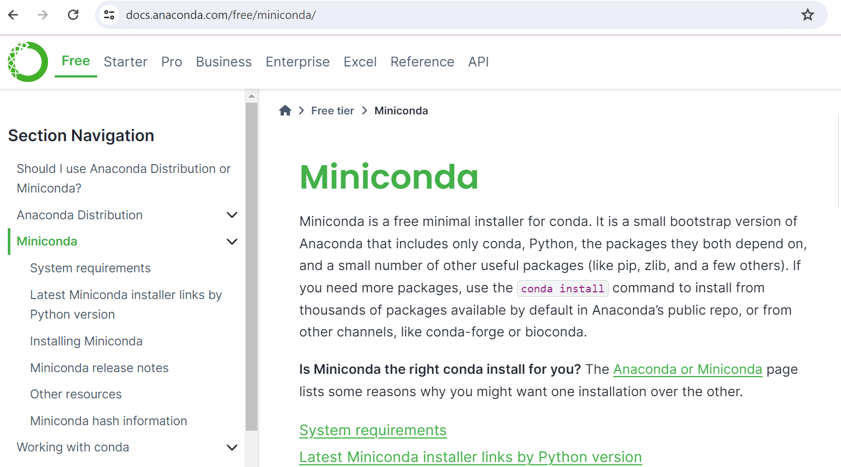
Conda Setup
We are going to use miniconda
Go to this website and download
the version for your system
May need to add execute privilege to the file, then run it
Simple conda commands Create environment in your folder:
replace python=3.7 with your version
Get yfinance package
chmod +x <.sh filename>
conda init
conda list
conda env list
conda install <whatever>
conda create –name <name> python=3.7
conda install –c conda-forge yfinance

Slide 27
Project Discussion/Work Time
Notes:
Idea:
We’ll write the platform to make and conduct trading strategies.
You guys will write and implement the strategies, test them on prior data
Alternate for more software-oriented people you guys could also make the platform
We can do this in python/C++, if python use numPy and Yahoo Finance data
Use matplotlib plot graphs, show that in pdf/md/html file through github

Slide 28

Attendance Form
This one
Link to Onboarding Document, Slack and Team Folder
http://tinyurl.com/5ad364cy
https://forms.gle/fZU7zFBUvnw92ces6

